Slide 1
Taming the Torrent: A Practical Approach to Reducing Cross-ISP Traffic in Peer-to-Peer Systems
David R. Choffnes and Fabián E. Bustamante
Northwestern University
SigComm 2008

Slide 2
The BitTorrent protocol
Over 66% of P2P users & growing
Distribute files through piece exchanges between collaborating peers
  A file for download is described by a torrent
  Peers sharing content are connected to the same torrent
Which peers? Trackers provide a random subset of peers in the torrent
  For a peer’s initial set of connections
  For new connections, as transfer progresses and other connections are dropped
David Choffnes, Taming the Torrent, SIGCOMM 2008
Notes:
Stronger connection to previous slide
Comment on BT taking over a good fraction of the multimedia flows

Slide 3
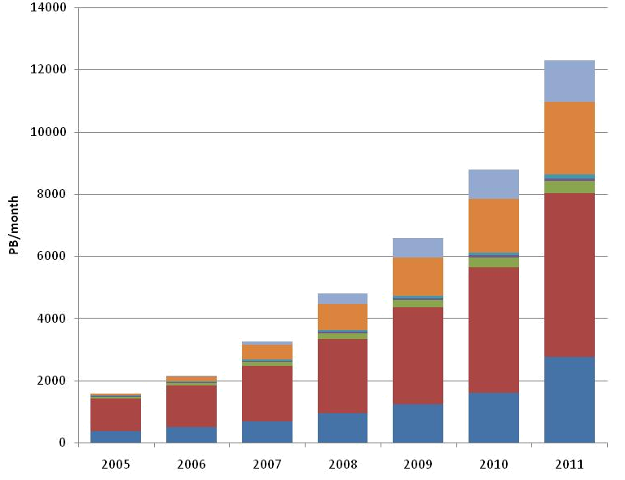
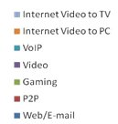
The ISP Perspective
P2P performance - key factor for service upgrade & selection by users
A major engineering challenge for ISPs
  ≈70% of the Internet traffic
  Random peer connections → growing ISP operation costs
Internet Video to TV
Internet Video to PC
Users pay flat rate, but ISPs see
increasing, expensive traffic volumes
VoIP
Video
Gaming
P2P
Web/E-mail
Source: Cisco
David Choffnes, Taming the Torrent, SIGCOMM 2008
Notes:
Make positive and negative clear
To say :oblivious of net topology & link costs

Slide 4
A Straightforward Approach
ISPs guide peers when choosing neighbors
  Help reduce cross-ISP traffic
First proposed by Bindal et al. (ICDCS 2006) and Aggarwal et al. (CCR 2007)
More recently – Xie et al. P4P (SIGCOMM 2008)
Two remaining issues
  Assumes P2P users & ISPs trust each other
  Misses incentive for user adoption

Slide 5

An Alternative, Practical Approach
CDNs are already collecting the necessary info
Various CDNs, e.g. Akamai, Limelight
  Serve popular sites e.g. NYTimes, Apple, Yahoo …
  Move load from providers to edge of network
How do they do it?
  Using thousands of replica servers worldwide
  Extensive network measurements to inform replica server selection
  Redirecting web-clients to web content replicas
Reuse CDNs’ net views for peer selection
  How? By simply comparing DNS redirections
Notes:
Present time

Slide 6


Reusing CDNs’ Network Views
Client’s request redirected to “nearby” server
  Client gets web site’s DNS CNAME entry with domain name in CDN network
  Hierarchy of CDN’s DNS servers direct client to nearby servers
Multiple redirections to find nearby edge servers
Internet
Hierarchy of CDN DNS servers
Customer DNS servers
Clients and replica servers are “nearby” [SIGCOMM ’06]
Web replica servers
Another web client
(3)
Client is given 2 web replica servers (fault tolerance)
(4)
Client gets CNAME entry with domain name in Akamai
(5)
(2)
(6)
Client requests translation for Yahoo
LDNS
(1)
Web client
Notes:
As we reported in SIGCOMM

Slide 7
Reusing CDNs’ network views
Hypotheses
  Links between “nearby” hosts cross few ISPs
  If two hosts are close to the same CDN replica servers, they are close to each other
Advantages
  Requires no additional infrastructure
  Needs no topological information
  Avoids the trust issue between ISPs and P2P
  Reduces cross-ISP traffic …
  while improving users’ transfer performance
Notes:
Before this slide, don’t read the text as much, say things different

Slide 8
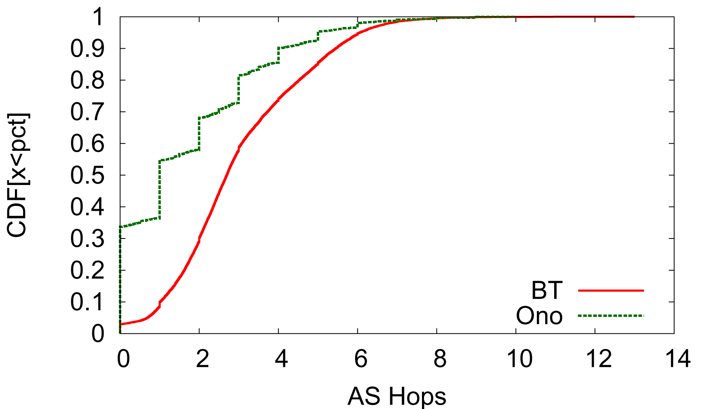
Results: Cross-ISP Traffic Reduced
Average number of AS hops to reach Ono-recommended/random peers
> 30% of paths to Ono-recommended peers do not leave the AS of origin
Note BT curve includes all peers, either Ono-recommended or randomly selected
Notes:
We use AS hops as a proxy for ISP hops, median is 1 hop, that’s the case for less than 10% of the random one.
This is the first study of the actual number of cross-ISP links, only 8.2% stay in same AS
Median for Ono is 1 AS hop, 3 for random
The quantization evident in the Ono curve is not from a lack of data (they are several thousands of data point there, > 5,000) . Rather, because each Ono peer sees a relatively small number of recommended Ono peers during an observation interval and because those peers are typically along short paths, the average of which takes on small range of values, often integers. Each point, the average of statistics recorded from one Ono peer over a six-hour interval.

